Slide 1
Business Income
Pub 4012 – Tab D: Self-Employment Income
Pub 4491 – Lesson 10
Tax-Aide Schedule C Guidelines
Notes:
1
Most of this lesson is intended for all volunteers who will be preparing Schedule C returns
Comprehensive topics are at the end
New counselors should be aware of these topics
Experienced counselors should have a good working knowledge
Emphasis should be placed on the interview – determine whether the return is in scope or not BEFORE starting the return
Note change in car washes inclusion in standard mileage rate

Slide 2
Lesson Topics
Business Income
Interview for Scope
Business codes
Business expense
TaxSlayer entry
Comprehensive topics
Notes:
Comprehensive topics include
Jointly run business
Statutory employees
Notaries public

Slide 3
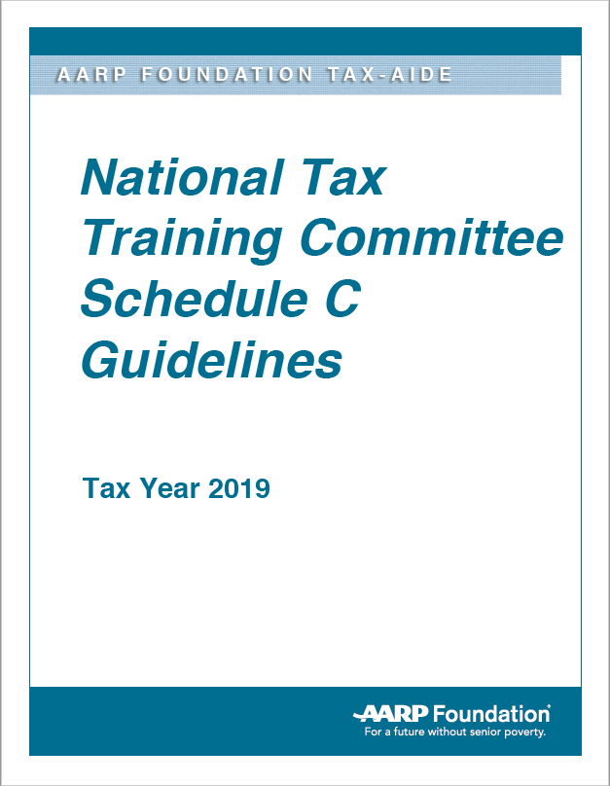
Tax-Aide Schedule C Guidelines
Helpful advice about business income and expenses
Available in AARP Volunteer Portal Library
Search for “Schedule C”

Slide 4
Business Income
Business income also called self-employment income
Reported on Schedule C
Include all business income
Reported or not
Subtract business expenses
Must be ordinary and necessary
Income minus expenses equals net profit or loss
Business loss out of scope

Slide 5
Net Profit
Net profit (or loss) used to calculate
Self-employment taxes
Total income
Qualified Business Income (QBI) deduction
Notes:
See slide deck 27 Standard and QBI Deduction –for QBI deduction information

Slide 6
Business Activity
May be sole proprietor or independent contractor
May be part time or full time
Primary business purpose for income or profit
Taxpayer involved in business with continuity and regularity
Notes:
Continuity does not mean all-the-time. For instance a seasonal business might only operate for part of the year, but it operates every year.

Slide 7
Interview – Consider Each Business Separately
Taxpayer may have more than one Schedule
Do not combine businesses
Each business requires separate Schedule C

Slide 8
Interview - Is it a Business?
Three choices when determining type of activity
Business — Schedule C
Income producing but not a business — Other Income
Activity not entered into for profit (e.g. hobby) – out of scope

Slide 9
Interview – Scope
Schedule C in scope when
Uses cash method of accounting
No net loss
No employees or paid contract labor for services
No SEP/SIMPLE contribution
Traditional or Roth IRA contributions are in scope
Notes:
Cash method as opposed to accrual method
All our Taxpayers normally satisfy the cash method requirement
Returns with a business loss have always been out of scope
If a new Taxpayer comes with a loss carryover, refer to a professional preparer

Slide 10
Interview – Scope
Schedule C in scope when
No prior year un-allowed passive activity losses from this business
No depreciation, amortization or asset write-off requiring Form 4562
Includes prior expenses taxpayer continues to depreciate or amortize
Notes:
Passive activities with losses are out of scope
Depreciation – the cost of items that are expected to last more than a year are spread over a period of years rather than deducted in the year of purchase.
If the taxpayers have such a cost from a prior year’s purchase, they should be referred to a professional tax preparer. Out of scope

Slide 11
Interview – Scope
Schedule C in scope when
No deduction for business use of home
Rent
Utilities (except business use of telephone)
Homeowner or renter insurance
Simplified home office method out of scope
No inventory carried over from prior years
Beginning 2018 all goods can be expensed when purchased

Slide 12
Interview – Scope
Schedule C in scope when
Claims mileage at standard rate
Claiming actual vehicle expense is out of scope
Business expenses of $25,000 or less per Schedule C
Not a bartering business
Notes:
Bartering – exchanging goods or services for other goods or services – out of scope
If a Taxpayer says they have received goods or services, refer them to a professional preparer
The value of what they received must be included in income

Slide 13
Interview – Scope
Due diligence
Does business sound reasonable
When not satisfied with taxpayer’s answers
Speak with Local Coordinator
Do not prepare the return
Decide during interview before return is started
Notes:
Emphasize:
Fraudsters will make up a business with no expenses just to get the EIC
One thing to check, is it being conducted “in a businesslike manner?” Are there businesslike records being maintained (i.e. a ledger or spreadsheet, receipts for expenses, copies of invoices/receipts given to customers)
ALL business expenses must be claimed
Watch for examples of incorrect, incomplete, or inconsistent information, such as:
• Schedule C income in round numbers
• Schedule C cash businesses as the only income on a return claiming EIC
• Schedule C with little or no expenses when expenses would be expected
• Schedule C taxpayers with little or no records for income and expenses
• Any Schedule C income that brings the taxpayer to the maximum EIC
• Schedule C without a Form 1099-MISC

Slide 14
Schedule C Quiz
Is this a business?
Income from recycling (conducted regularly)
Poll worker
Babysitter
One-time executor fee
Caregiver
Who is a relative
Who is not a relative
Yes
No
Yes – if not a household employee
No – unless in the business
No – unless in the business
Yes – if not a household employee
Notes:
Answers:
Recycling: yes
Poll worker: no
Babysitter: yes
One-time executor: no, if not in business of being an executor (e.g. for a deceased family member or friend)
Related caregiver: only if taxpayer is in the business of caregiving; otherwise no
Unrelated caregiver: yes
Caregivers that are properly considered household employees may report their income as wages on 1040 L 7 IF the total received from that service recipient is less than $2,000 for the year
If there are multiple service recipients and each is less than $2,000, they may all be reported as wages
Use Notes feature to add up multiple recipients
If the amount received from any one recipient, the Taxpayer has a choice of reporting on Sch C as a business or using Form 8919 to “turn in” their employer
Form 8919 is out of scope

Slide 15
Employee Receives Form 1099-MISC
Taxpayer receives Form 1099-MISC in lieu of W-2
Employer treats taxpayer as independent contractor and withholds no taxes
Taxpayer has three options
File Schedule C
Deduct work-related expenses
Pay self-employment tax (both employer and employee portions of Medicare and Social Security tax)
Or

Slide 16
Employee Receives Form 1099-MISC
Request employer reimburse half the self-employment tax
Or
Taxpayer files claim with the IRS (Form SS-8)
IRS will determine if taxpayer employee or contractor
After determination: Taxpayer files Form 8919 to calculate taxpayer’s share of employment taxes – out of scope
Taxpayer may wish to find a new job before filing Form SS-8
Notes:
Many taxpayers may not want to take these steps our of fear of losing their job. It is their choice, but SE taxes must then be paid.

Slide 17
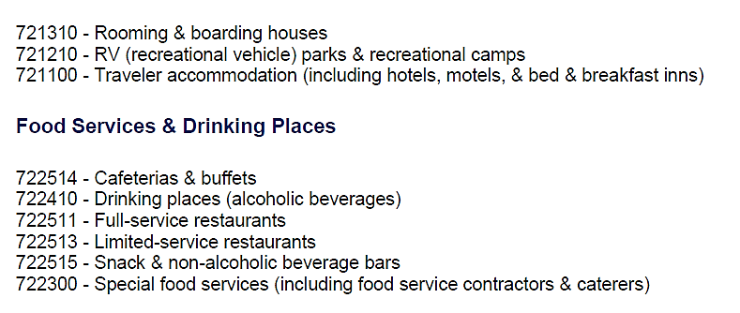
Business Code
Or use cotaxaide.org/tools to look up code
Select code from the list
Notes:
Graphic designer:
Category: Professional, Scientific, & Technical Services
Code: Graphic designer: 541400

Slide 18
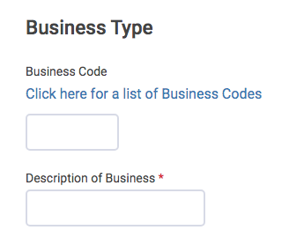
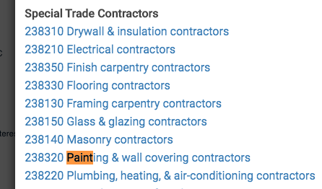
Business Codes in TaxSlayer
Click for list of Business Codes
Enter Control F to bring up search box
Type in job description to bring up code
Click on code to enter in TaxSlayer
Notes:
Control + F will help find codes. Not a perfect system.

Slide 19
Business Code Quiz
Determine business code
Janitorial Services
Independent ….. Artist….Performer
Educational Services
Uber Driver
561720
711510
611000
485990
Notes:
Ask to look up codes or if running TS, demonstrate in program
Uber driver is listed under “other transit”

Slide 20
Business Income
Report business income on Schedule C Line 1 as gross receipts
Do not use line 6 Other
Include business income
Reported on Form 1099-MISC
Reported on Form 1099-K
Not reported on tax form (cash or tip income)
Notes:
Consider the business.
Is it likely that the Taxpayer would have cash income?
If so, ask about it.
All Income must be reported.
All Form 1099-MISCs must be input into TaxSlayer as a 1099-MISC (not summarized to “other income”)

Slide 21
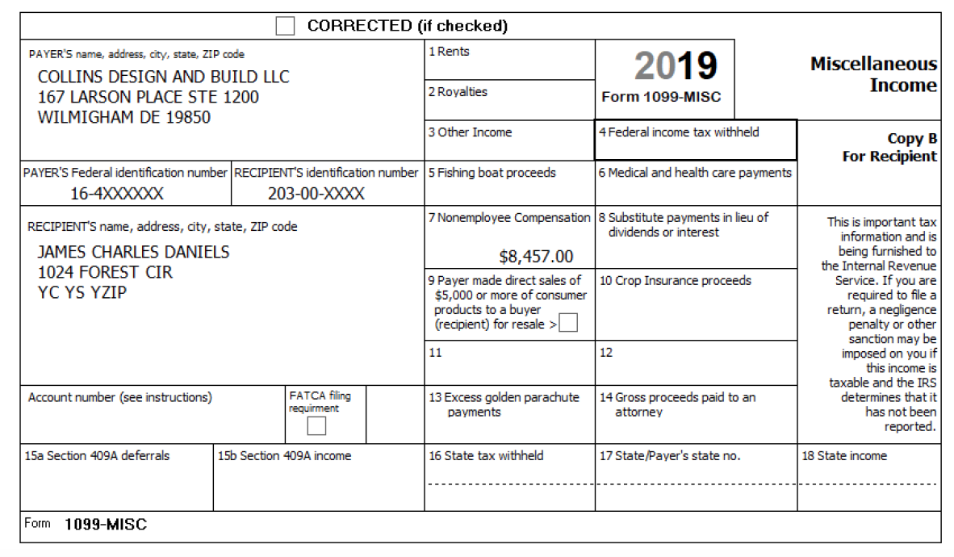
Business Income – 1099-MISC
May need to enter income in a different box in TaxSlayer to correctly report on return
If Schedule C income, move to Box 7
If not Schedule C income, move to Box 3
Notes:
See Slide Deck 25

Slide 22
TaxSlayer Entry Form 1099-MISC
Pub 4012 Tab D
Go to Federal income screen or search 1099-MISC
Enter data from Form 1099-MISC
Create new business (Schedule C) or
Add to an existing business (edit)
TaxSlayer Icon: adds Form 1099-MISC to existing Schedule C
Notes:
Edit symbol means ADD to this Schedule C

Slide 23
Business Income – Form 1099-K
Pub 4012 Tab D
Payment Card and Third Party Network Transactions
used to report income for taxpayers who accept credit cards
May not receive Form 1099-K if less than $600
Enter on Schedule C as cash income
Do not enter on Form 1099-MISC

Slide 24
Business Income Quiz
What types of income should you expect to see?
A wedding singer
Checks and cash (tips and gratuities)
A graphic designer
Form 1099-MISC if over $600
Checks or cash for small jobs
Notes:
Encourage audience participation
Emphasize to use common sense
Instead of asking “did you receive any tips”, maybe ask “how much in tips did you receive” (This question is NOT a yes/no question. It requires thought.)

Slide 25
Business Expense
Business expenses must be ordinary and necessary
Not against public policy
Cannot deduct fines or penalties
All allowable and documented expenses must be claimed
Not claiming an expense may result in additional tax benefits
Example: to improve EIC – not allowed
Notes:
Review how good records help taxpayers: Refer to 4012 F-13
Monitor the progress of their business
Prepare their financial statements
Identify source of receipts
Keep track of deductible expenses
Prepare tax returns
Support items reported on tax returns
Ask: What are examples of business-related supporting documents?
Answer: Sales slips, paid bills, invoices, receipts, deposit slips, canceled checks.

Slide 26
Business Expense – Cost of Goods Sold
New: Cash-basis taxpayer can account for purchases as an expense
No inventory accounting needed
Goods produced for sale
Goods purchased for resale
Enter total purchases paid as Supplies in General Expenses or as Other Expense

Slide 27
Business Expense Quiz
Are these items deductible? In scope?
Employee benefit programs
Pension and profit sharing
Wages
Out of scope – all relate to employees

Slide 28
Business Expense Quiz
Are these items deductible? In scope?
Commissions and fees paid
Contract labor payments
Legal and professional services
All three are deductible
Contract labor payments are out of scope

Slide 29
Business Mileage
Two methods to calculate business mileage
Actual expense method out of scope
or
Standard mileage rate method
Refer taxpayers using actual method to professional preparer
Notes:
Actual Expense Method:
The taxpayer determines the business portion of expenses for fuel, auto maintenance, parking fees and tolls, and auto loan interest
The actual expense method is out of scope.
Actual expense requires depreciation of vehicle – even if not claimed and is therefore out of scope
Standard Mileage Method: the taxpayer multiplies the business miles by the mileage rate for that tax year.

Slide 30
Standard Mileage Method
Standard mileage rate includes:
Car depreciation or lease payments
Gasoline, oil, etc.
Repairs and maintenance
Regular car insurance
Car registration (non-tax portion)
Car washes
Do not include as additional expense on Schedule C
Notes:
Items not included in standard mileage rate can be a deductible expense on Schedule C in addition to standard mileage rate
Taxpayer should determine the business portion, e.g. relative miles, relative time used, incurred only for business

Slide 31
Standard Mileage Method
Standard mileage rate does not include:
Parking
Tolls
Car registration (property tax portion)
Interest on car loan (business portion only)
Include as additional expense on Schedule C
Notes:
Items not included in standard mileage rate can be a deductible expense on Schedule C in addition to standard mileage rate
Taxpayer should determine the business portion, e.g. relative miles, relative time used, incurred only for business

Slide 32
Business Mileage
Pub 4012, Tab D
Commuting versus deductible transportation miles
First and last trip of the day nondeductible commuting miles
Business miles in between first and last trip deductible
First and last trip of the day deductible mileage with home office deduction – out of scope
Refer taxpayer to professional preparer to claim home office deduction and increased mileage
Taxpayer determines business miles

Slide 33
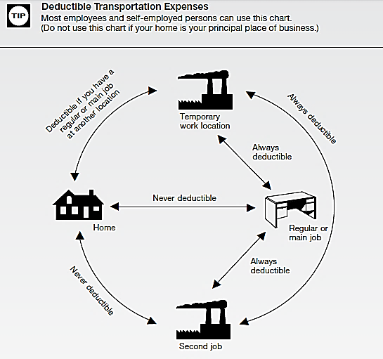
First trip out and last trip home = Commuting mileage not deductible
In between mileage = Deductible business mileage

Slide 34
Business Mileage Quiz
Taxpayer claims business mileage and keeps records
Taxpayer has car accident while on business
Is insurance “deductible” deductible?
No – insurance (or the cost of self-insuring) is included in standard mileage rate

Slide 35
Business Mileage Quiz
Pub 4012 Tab D
Taxpayer claims business mileage and keeps records
Taxpayer is paying interest on their car loan
Is interest on the car loan deductible?
Yes, the business percentage of interest on car is deductible in addition to standard mileage rate
Notes:
One way to determine business percentage:
Total car loan interest paid during the year $400
Total miles driven during the year = 20,000
Deductible business miles driven during the year = 1,800
1,800 ÷ 20,000 = .09
.09 X $400 = $36 deductible car loan interest on Schedule C
Make sure you do not include entire amount paid for the car during the year – which includes principle. Use only the interest paid on the car loan in the calculation.

Slide 36
Business Expenses – For-Hire Drivers
For-hire drivers may add other deductible expenses
Cellular service (business portion)
Fees
Beverages/snacks for passengers
Ride sharing insurance in addition to standard mileage rate
Notes:
Examples include Uber, Lyft, DoorDash, GrubHub, and other drivers

Slide 37
Business Expense – Outside Office
Rent (if filing Form 1099 for payment not required)
Office expenses (postage, supplies, etc.)
Insurance
Taxes
Business telephone and utilities
Home office deduction out of scope
Notes:
A 1099 is not required to be issued to a corporation
Cannot claim depreciation on the outside office!

Slide 38
Business Expenses - De minimis election
Tools or equipment expected to last more than one year but costing less than $2,500 per item or invoice can be deductible business expense – in scope
List on Schedule C as “Other Expense”
Describe as “De minimis election under regs” and amount being expensed

Slide 39
Business Expenses – Education Costs
Tuition and fees, course-related books, supplies and equipment
Parking and transportation (both to and from school)
Travel expenses if out of town
Needed to maintain or improve skills needed for present business
Does not have to be a qualifying educational institution

Slide 40
Business Expense – Computer
Computer costing more than $2,500 – out of scope
Only the business use percentage can be deducted
May claim supplies used for business
Example: paper, toner
Notes:
Asset write-off over $2,500 (either immediate or through depreciation) is out of scope
Computer and peripherals are also “listed property” which require documented business use in order to claim depreciation or write-off
Supplies used for business are not assets – if they are used for business, they are deductible

Slide 41
Business Expenses – Telephone
Business telephone – dedicated phone used only for business – 100% deductible
Mixed-use landline phone
Basic service not deductible
Actual cost of business calls deductible
Mixed-use cell phone
Prorate cost based on business use
Notes:
Sanity check: is it reasonable?
100% business cell phone when Taxpayer has only one phone?
100% business internet fee? No personal use?
Business records are very important – although we do not need to see them

Slide 42
Business Expenses – Meals
50% cost of meal is deductible
TaxSlayer makes calculation
Special documentation rules apply if business meal over $75.00
Starting in 2018 business entertainment expenses not deductible
check state conformity
Recordkeeping taxpayer’s responsibility
Notes:
Emphasize
Advise taxpayers of recordkeeping requirements
Note: entertainment expenses are no longer deductible starting tax year 2018

Slide 43
Health Insurance Deduction
Self-employed health insurance premiums deductable as an adjustment to income
Entered in TaxSlayer on Schedule C screen
Not a business expense
Does not reduce net profit
Claimed as adjustment to gross income
Limited to net profit minus ½ self-employment tax
See Adjustments to Income lesson
Notes:
Generally, use the input on Sch C > General Expenses
If more than one Schedule C, enter in Adjustments Section

Slide 44
Schedule C Net Profit
TaxSlayer uses Schedule C net profit to calculate
Self-employment tax
Except statutory employee
Traditional IRA
See Adjustments to Income lesson
Earned income credit
Qualified business income deduction
See Standard and QBI Deduction lesson
Notes:
Qualified business income deduction should flow in TaxSlayer
Verify during quality review

Slide 45
Business Income – Quality Review
Confirm income is business income
Verify all Forms 1099-MISC in TaxSlayer agree with originals
EIN, payer name, address, etc.
Confirm Schedule C net profit agrees with taxpayer records
Compare net profit to prior year
Confirm differences

Slide 46
Business Income Quality Review
Verify all business expenses included
Health insurance costs claimed as adjustment to income
Education expenses that could or should be deducted on Schedule C
Confirm qualified business deduction correctly computed
Verify state return entries

Slide 47
Business Income – Taxpayer Summary
Emphasize need to keep good records
Can be paper or electronic
Assures all income is accounted for
Assures no expenses are forgotten
Greatly facilitates tax return preparation
Notes:
If taxpayer has business checkbook, can be main source for entries in the business books.
In addition, supporting documents must be kept.

Slide 48
Business Income
Comprehensive Topics

Slide 49
Business Income – Comprehensive Topics
Is it a business?
Jointly run business
Statutory employees
Notaries public
Notes:
All Counselors should be aware that special rules apply

Slide 50
Interview – Is it a Business?
A Business
Profit motive
Reasonable expectation of profit
Means of livelihood
Regular activity
Conducted in a business-like manner
Notes:
One-time payments may or may not be a business
Sporadic activity may not be a business – but once a year, every year might be a business
Income cannot be on a W-2 – except statutory employees

Slide 51
Interview – Is it a Business?
Income producing but not a business—Other income
Income from activities that don’t meet requirements to be considered a business
Sporadic activity, e.g., one-time event
Report income as “Other Income”
Generally deductions not allowed
Notes:
One-time payments may or may not be a business
Sporadic activity may not be a business – but once a year, every year might be a business

Slide 52
Interview – Is it a Business?
Not Entered Into for Profit — out of scope
Antique hunting, when not in the business
Usually more pleasure driven than income driven
On-going activities not entered into for profit are out of scope
Notes:
If this is an issue for your district here are the business vs. hobby criteria:
1. The manner that a taxpayer carries on an activity.
2. The expertise of a taxpayer or advisor(s) involved in the business activity.
3. The time and effort a taxpayer allocates to the activity.
4. Has the taxpayer had success with similar or dissimilar activities in the past?
5. The history of income/loss for the activity.
6. Are there occasional profits and, if so, how much are they?
7. The financial status of the taxpayer, and does the taxpayer rely on this business activity or does the taxpayer have other sources of income?
8. Is there an expectation of asset appreciation for any assets involved in the business activity?
9. Are there elements of personal pleasure or recreation?

Slide 53
Jointly Run Business
Jointly run business must be split into two Schedules C
Self-employment tax implications
Can enter all income and expenses on one Schedule C and mark “Qualified Joint Venture”
Notes:
Community property laws are disregarded for self-employment tax purposes
If jointly run business, Taxpayer needs to specify the split ratio
Splitting: Cannot use an expense to move the spouse’s share
TaxSlayer does not allow a negative expense so would need use an income account for the spouse
Means gross income will be overstated, e.g. for ACA purposes
Can add an explanatory statement in TaxSlayer that is e-filed

Slide 54
Jointly Run Business
If other than 50:50 split, enter all income on one Schedule C, then “Move” the other spouse’s share to a separate Schedule C
Input an as “Returns and allowances” on the first Schedule C
Input as “Other Income” on the other spouse’s Schedule C
Taxpayer decides the portion allocable to each spouse
Notes:
Community property laws are disregarded for self-employment tax purposes
If jointly run business, Taxpayer needs to specify the split ratio
Splitting: Cannot use an expense to move the spouse’s share
TaxSlayer does not allow a negative expense so would need use an income account for the spouse
Means gross income will be overstated, e.g. for ACA purposes
Can add an explanatory statement in TaxSlayer that is e-filed

Slide 55
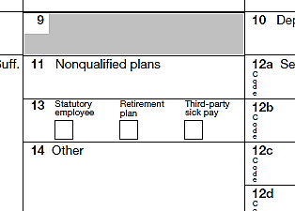
Statutory Employee
Statutory employee on Form W-2
Related expenses claimed on Schedule C
Input W-2 form and check statutory employee box
Input income again on Schedule C
Regular Schedule C rules apply for expenses
No self-employment tax (FICA withheld via W-2)
Notes:
Statutory employees are rarely encountered
What!?!?! Business income on a W-2??? Special situation.
Statutory employees are a mixed situation
Income reported on W-2 instead of 1099-MISC
Some taxes are withheld
Can take business expenses on Schedule C

Slide 56
Statutory Employee
Statutory Employees include:
Certain agents or commission drivers
Full-time life insurance salespersons
Certain homeworkers
Traveling salespersons
Some employers may check the box in error
Notes:
If it doesn’t sound right, report on W-2 form and/or suggest Taxpayer gets a corrected W-2
“Employer” will withhold social security and Medicare taxes from statutory employee, maybe federal tax
No self-employment tax!
An explanation from IRS.gov of these workers:
A driver who distributes beverages (other than milk) or meat, vegetable, fruit, or bakery products; or who picks up and delivers laundry or dry cleaning, if the driver is your agent or is paid on commission.
A full-time life insurance sales agent whose principal business activity is selling life insurance or annuity contracts, or both, primarily for one life insurance company.
An individual who works at home on materials or goods that you supply and that must be returned to you or to a person you name, if you also furnish specifications for the work to be done.
A full-time traveling or city salesperson who works on your behalf and turns in orders to you from wholesalers, retailers, contractors, or operators of hotels, restaurants, or other similar establishments. The goods sold must be merchandise for resale or supplies for use in the buyer’s business operation. The work performed for you must be the salesperson's principal business activity.

Slide 57
Notaries Public
All normal rules apply for income and business expenses
Notaries exempt from self-employment tax by law
Income does not qualify for EIC
Enter in TaxSlayer Schedule SE the amount of net profit (Schedule C profit) exempt from self-employment tax

Slide 58
Business Income
Questions?
Comments…
Notes:
58

